Slide 1

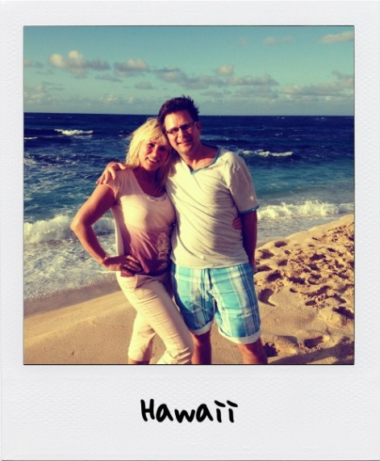

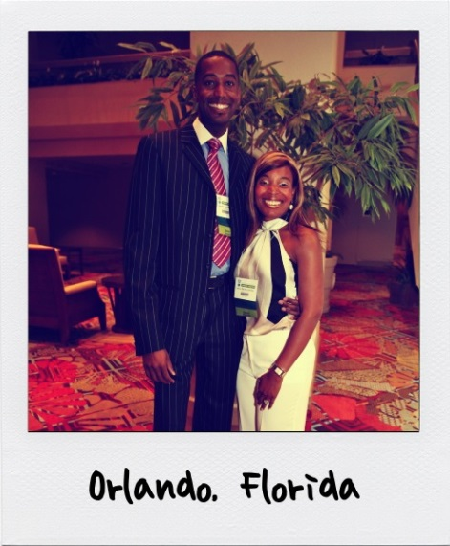
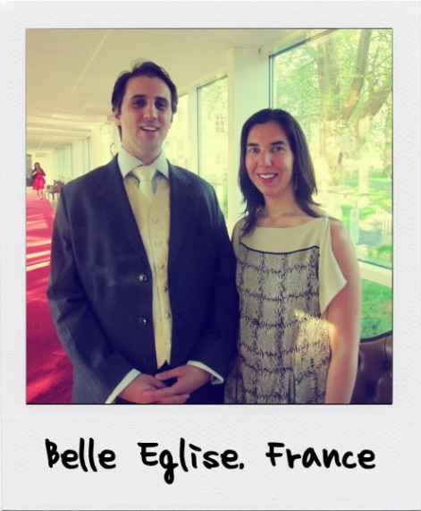
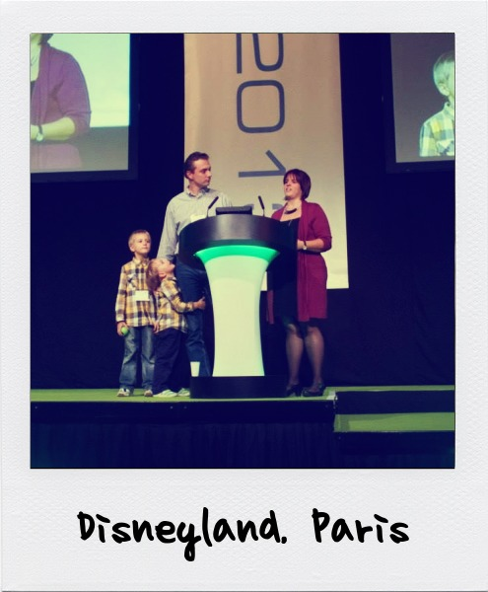



Welcome

Slide 2
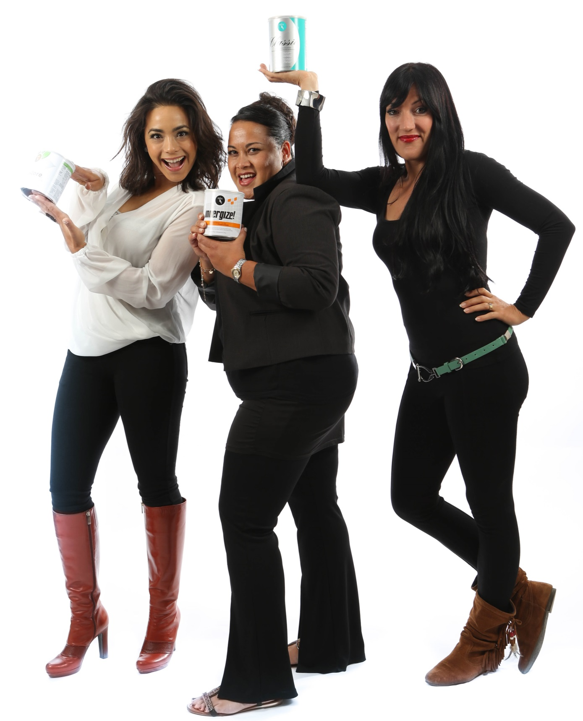
Reliv Basic Training
Great benefits in Reliv –
all lines work together
Respect each other’s business model
Questions or differences in what you hear today? It’s wise to follow your Upline’s business model – they will be working with you regularly.
Teamwork is key!

Slide 3
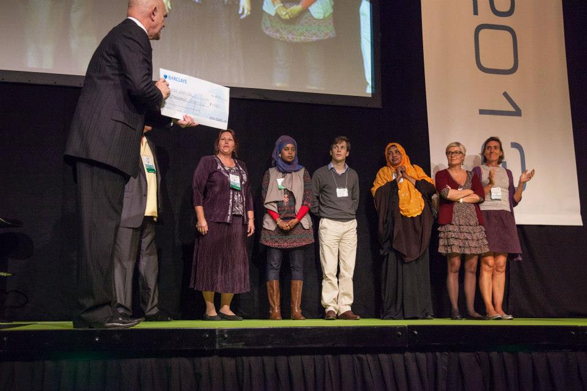
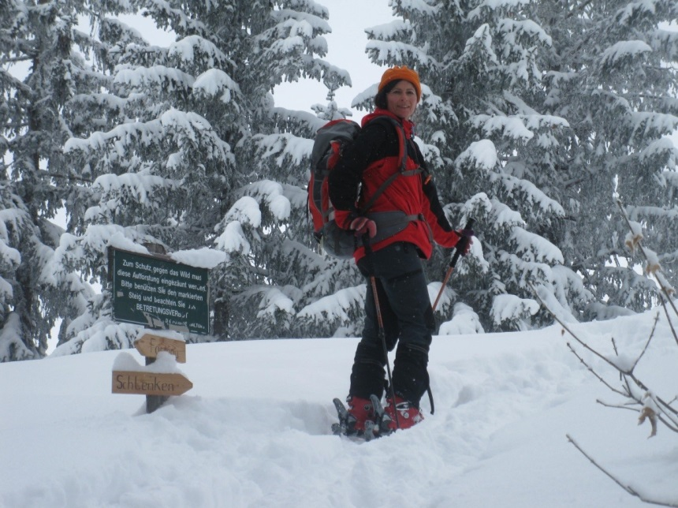

Why Reliv?
Financial freedom
Family freedom
Be your own boss
Live the life you want
Why are you here?

Slide 4


Kalogris Foundation:
The Reliv Mission
40,000+ people fed daily through the Reliv Kalogris Foundation
Hundreds of nutritional programmes in 9 countries
Distributor-supported
"Be ashamed to die until you have scored a victory for mankind"

Slide 5

Reliv is Unique
Stability – 25+ years
Reliv-owned and operated manufacturing facility
Cutting-edge research and development team
International opportunity
A proven Success System
Patented formulas that are safe and effective

Slide 6

Product Line

Slide 7

Your Business Starts With You
Be a product of the product
Reliv products work!
The Reliv business works!
Let’s share some examples…
You can answer any questions with stories, stories, stories!
Be visible — product/business

Slide 8

Define Your Goals
Discuss your goals with your Upline
  – Short-term
  – Long-term
Define your Reliv working hours
Fast Start? Master Affiliate?
Make a Plan of Action

Slide 9

Growth Comes From New People
Sharing the whole Reliv picture
– Company
– Products
– Mission
– Opportunity
Leads to…
– New Customers
– Distributors and Master Affiliates
– Referrals
Sponsoring + Volume = Momentum

Slide 10
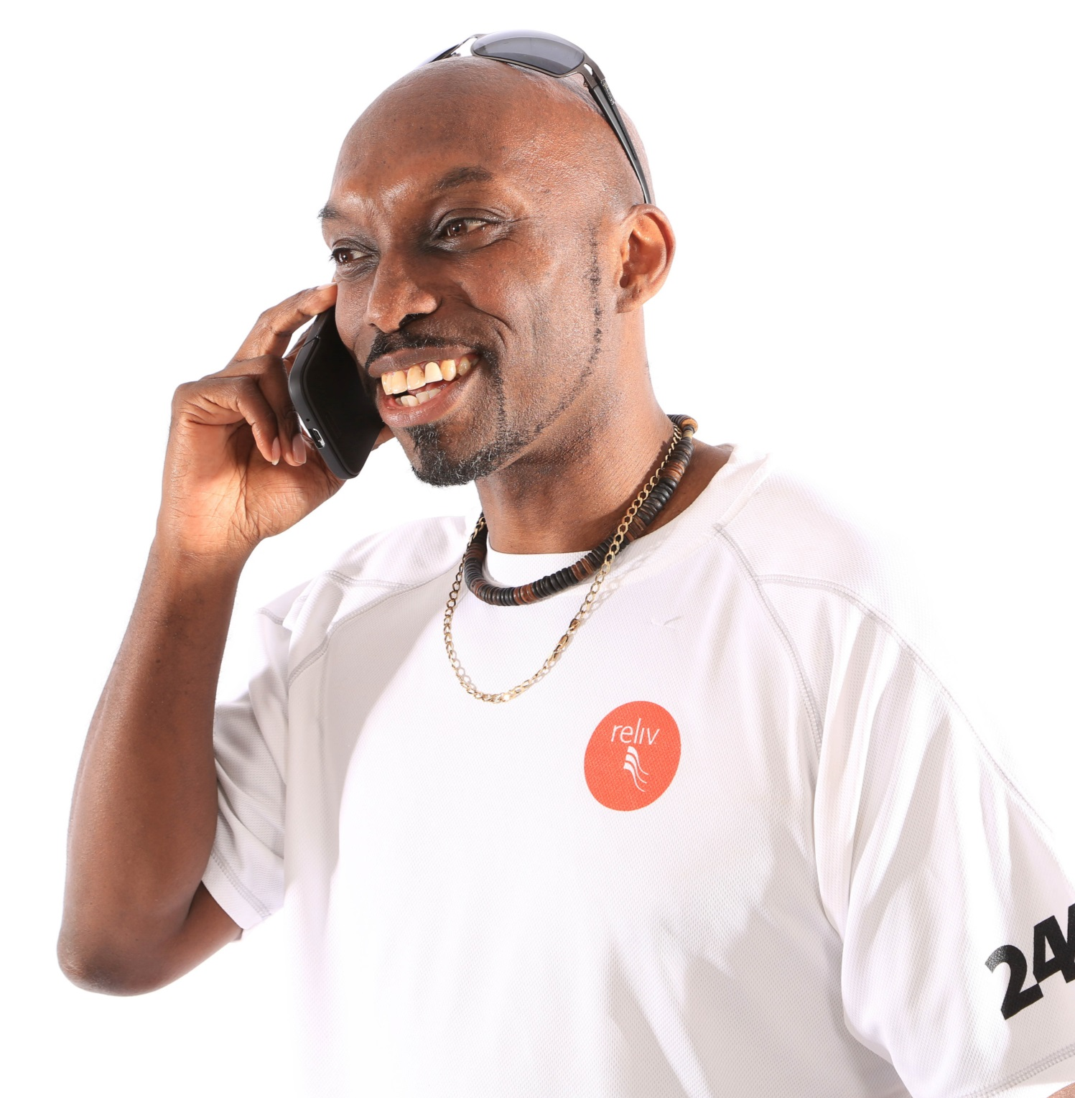
Your Contact Plan
Identify “who” you will talk to
Your hot market list:
people you know
Your warm market list:
referrals
Your cold market list:
everyone else
Examples

Slide 11
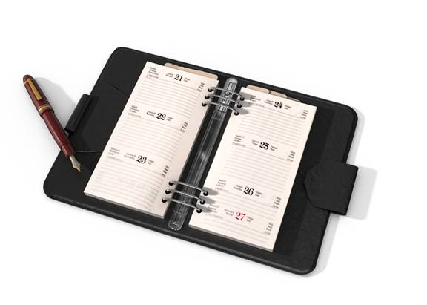
Set up Appointments
Share your excitement first, it is contagious!
GOAL: Set an appointment with your upline
Get examples of opening sentences
Use the elements of the system to communicate and expose people
Have a sense of urgency
People respond to your enthusiasm
and conviction!

Slide 12

Hold an Appointment
Use your Upline
Connect to other’s stories
Use the Reliv tools: 3-way calls, replay lines, meetings, skype, etc.
Always ask for a decision

Slide 13
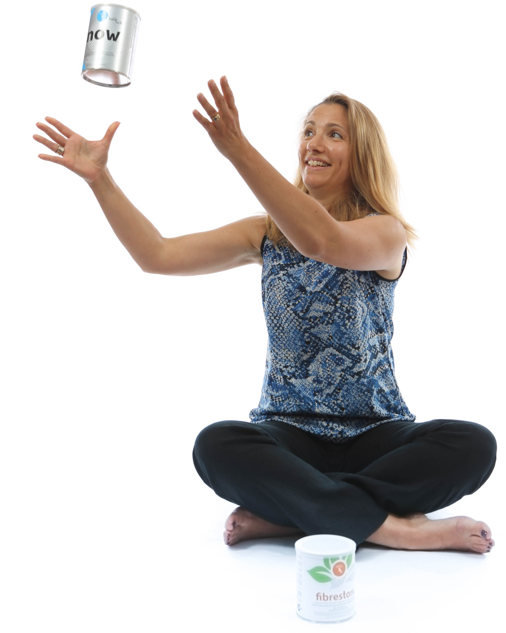
Ask For a Decision:
Products
Where do you want to get started?
Ask questions and listen
Recommend: Fast Start?
Personalised needs?
Keep it simple
Show them ways to save on the products.
Who do you know who can benefit from
Reliv products?

Slide 14

Ask For a Decision: Business
Where do you want to get started?
Review profit options
Revisit compensation plan
Ask questions and listen
Help your prospect to see their potential and select the best option
Get them started on the products.
Fast Start? Master Affiliate?
Who do you know who might want to start a Reliv business?

Slide 15

Follow-Up With Your Customers
Use the Reliv System to help you
Your sponsor will show you how
Benefits of a good follow-up:
Consistency = Great results
Customers become Distributors/MAs
Leads to referrals and duplication

Slide 16
Follow-Up With Your Customers
Fill out a customer questionnaire
Help customers with product regimen and connect
with stories
Keep It Simple
    Who do you know who could benefit from these products or this business opportunity?
Did you take your ‘shake’ today?
Are you consistent?
How are you feeling?
Day 1
Day 3
Day 10

Slide 17

Follow-Up With Your Distributors
Set Distributors Up to Succeed with immediate ACTION
Identify — Build a list
Connect — Who to call first?
Share the Story — Set the first appointments
within 72 hours
Benefits of a good follow-up
Distributors thriving means your bonus increases
Distributors become Master Affiliates and
advance further
Leads to referrals and duplication
Show them where to find support :
Distributor Kit, Reliv website, genealogy, other Distributors, etc.

Slide 18



Build Your Team
Develop a library of stories
Use your Upline, Downline, other Distributors, tools, the Reliv System
Stay connected with Reliv
  E-mails, calls, videos, social media
Set goals
  Review the road to Presidential Director
  Widen your Downline’s horizons
  Set advancement goals
To build Ambassadors, you need to build relationships

Slide 19
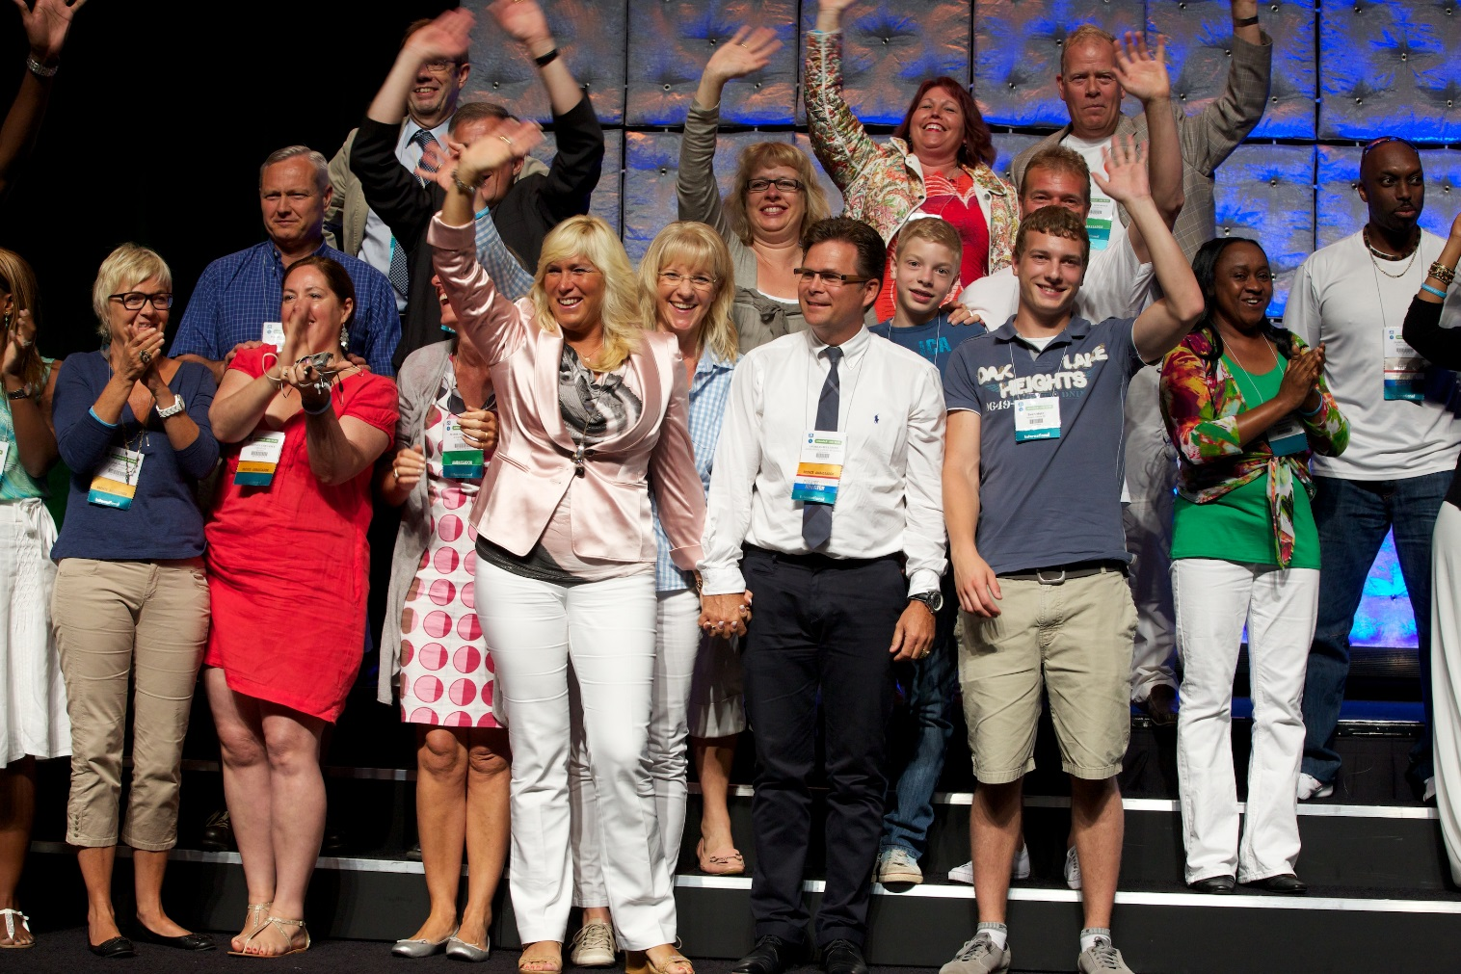
How the Reliv System Benefits You
Expands picture of Reliv
Reality vs. Opinion
Builds wall of belief
Builds relationships
Develops leaders
Promotes duplication worldwide

Slide 20

Connect Using the Reliv System
Upline
3-Way Calls
Monday Night
Conference Calls
Tuesday Business
Opportunity Meetings
Saturday Basic Training
Special Events / MATS
Conferences

Slide 21

Upline: Your First Element
Always remember, you and your Upline are a team
Learn from your Upline
Teach and support your Downline
The business is learned by doing
Do the business together

Slide 22

Upline: 2 on 1 Appointment
Your Upline contributes:
Their Reliv Story
Strength – a bigger picture
Experience – stories, strategies
How to present the
compensation plan
How to create great follow-up
Sponsor’s Goal:
Empower New Distributor

Slide 23

3-Way Calls
Set up call to win
Highlight person who is sharing
their story
More stories add weight of evidence
End call on a positive action note
Build relationships and have fun!
STORIES, STORIES, STORIES!

Slide 24

Monday Night Conference Call
Great success stories
Successful Reliv leaders come straight to you
Business basics reinforced
Helps build your confidence
and effectiveness

Slide 25






Monday Night Conference Call
English Language Call - Monday Night: 7.30 pm GMT
Freephone from UK: 0800 229 0708, mobile number from UK: 033 0336 0036
PARTICIPANT PIN: 099632
French Language Call - Monday Night: 9pm CET
Freephone from France: 080 510 2955, mobile number from France: 017 675 3294
PARTICIPANT PIN: 780100
German Language Call - Monday Night: 8.30pm CET
Freephone from Germany: 0800 723 7851, mobile number from Germany: 021197190003
PARTICIPANT PIN: 455020
Dutch language call - Monday Night: 8.30pm CET
Freephone from Netherlands: 0800 023 2580, mobile number from Netherlands:
0207 095 021
PARTICIPANT PIN : 911734
Ireland : 015 209 161 (Enter respective PIN)
Austria: 0268 2205 6633 (Enter respective PIN)

Slide 26
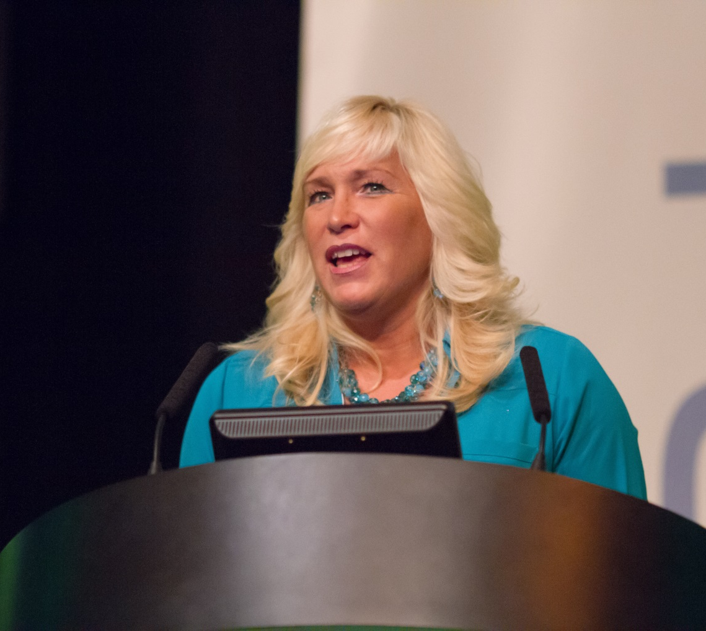
Business Opportunity Meeting
Takes place every Tuesday
Shares excitement and paints a bigger picture
Opportunity to network stories and build relationships
Continually grows your own wall of belief

Slide 27
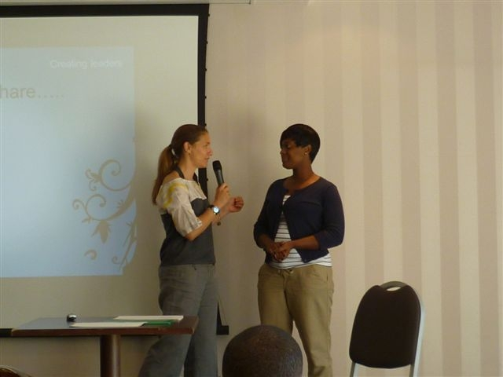
Saturday Basic Training
Another opportunity for
guests to see Reliv
Another opportunity to
network and share stories
Build new leaders/duplicate
Get Distributors involved
Master the Basics to Succeed!

Slide 28
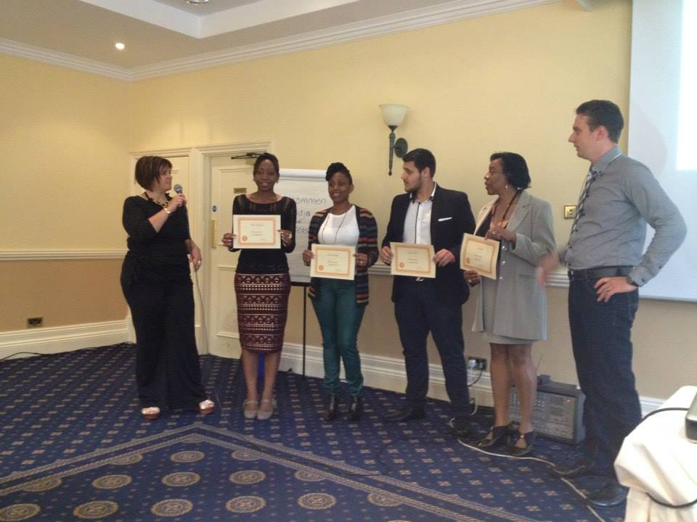
Special Events/MATS
Leadership training
Qualify yourself – every time
Help others to qualify
Measure growth by the number of people you have at MATS
Use MATS to Advance

Slide 29
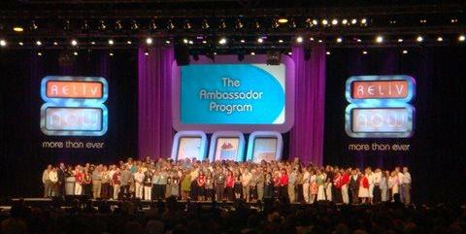
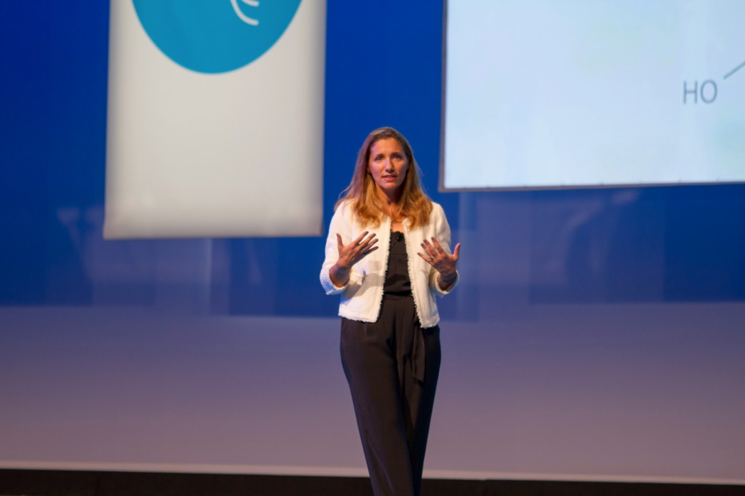
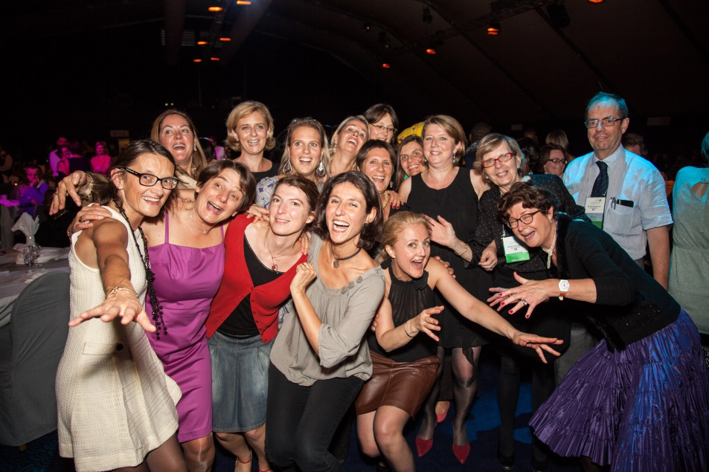
Conferences
The BIGGEST PICTURE
Shows reality of size and scope of Reliv
Build from conference to conference
Grows your wall
of belief
Experience the Heart of Reliv!

Slide 30


The Reliv System
Business Cycle
International Conference
Special Events Special Events
European Conference
Ongoing Activity
Monday Night Calls
Presentations
Tuesday Meetings
3-Way Calls
MATS
Training
Corporate Support
Monday Night Calls
Support Tools
Website

Slide 31
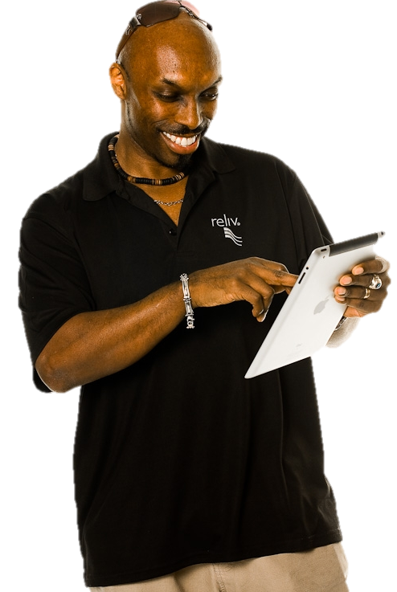
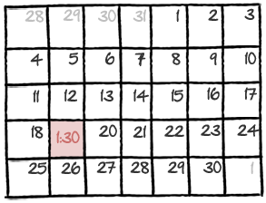
Your Weekly Action Plan
Your goals this week
Add names to your list
How many people will learn about Reliv this week?
How many people will see a Reliv System element?
More appointments = growth
What to promote NOW
Upcoming events
Current promotions

Slide 32

Your Goals for This Month
Working towards Master Affiliate?
Know your next step
What do you need to do to get there?
Already a Master Affiliate?
What is your next Advancement goal?
Know what comes next. Ask your Upline!
What will it take to get there?
Work the Star Director Programme
Learn how the programme works
How many new Master Affiliates will it take to advance to the next level?

Slide 33
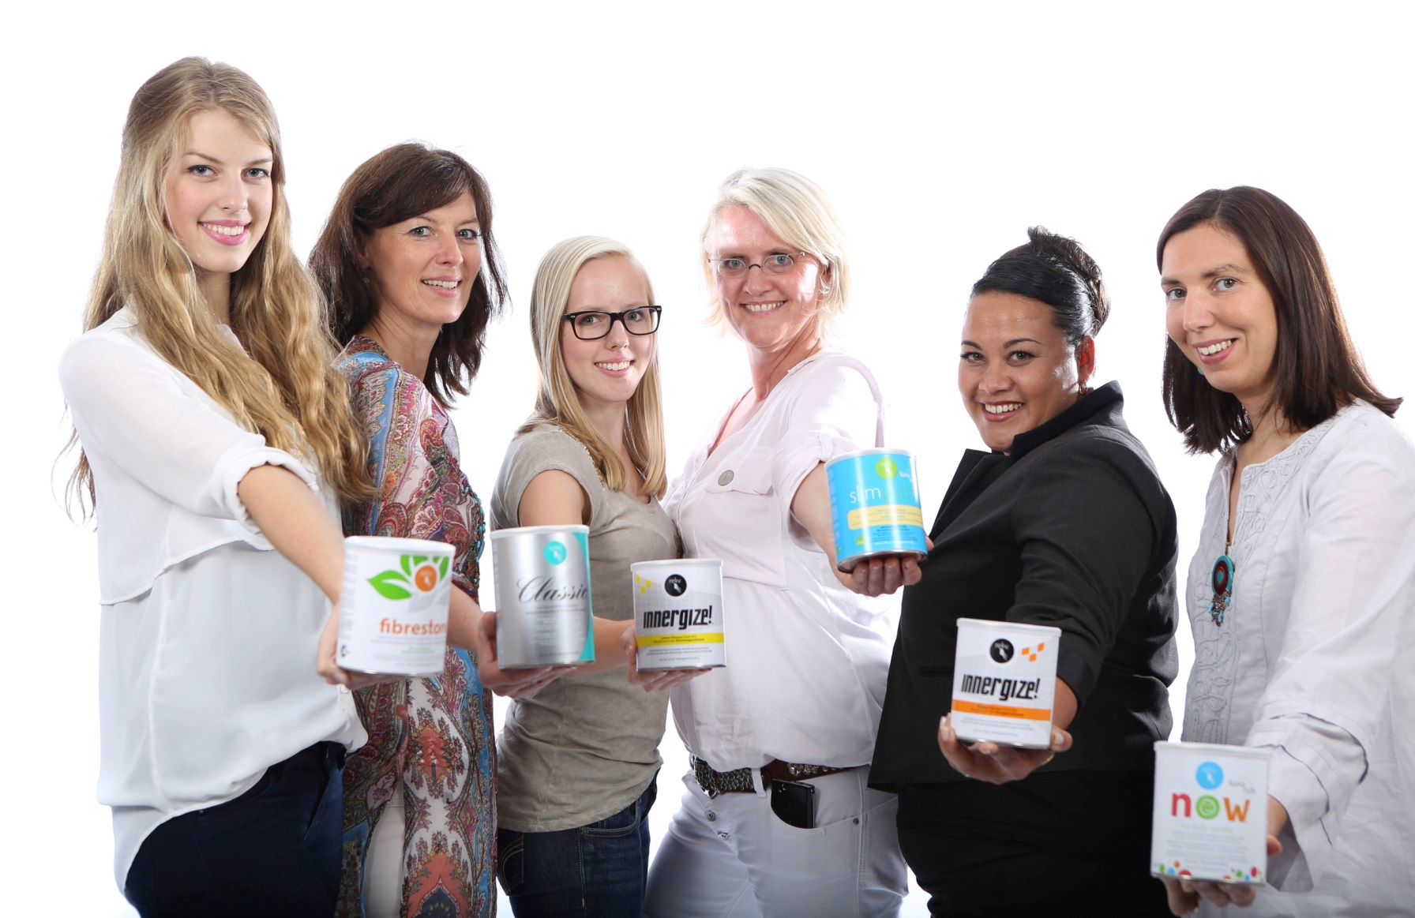
Importance of Attitudes
Remember:
Reliv can help EVERYONE!
Ups and downs – just like life,
the Reliv System helps us to
keep each other UP!
Persistence + Consistency +
Determination = Success!

Slide 34
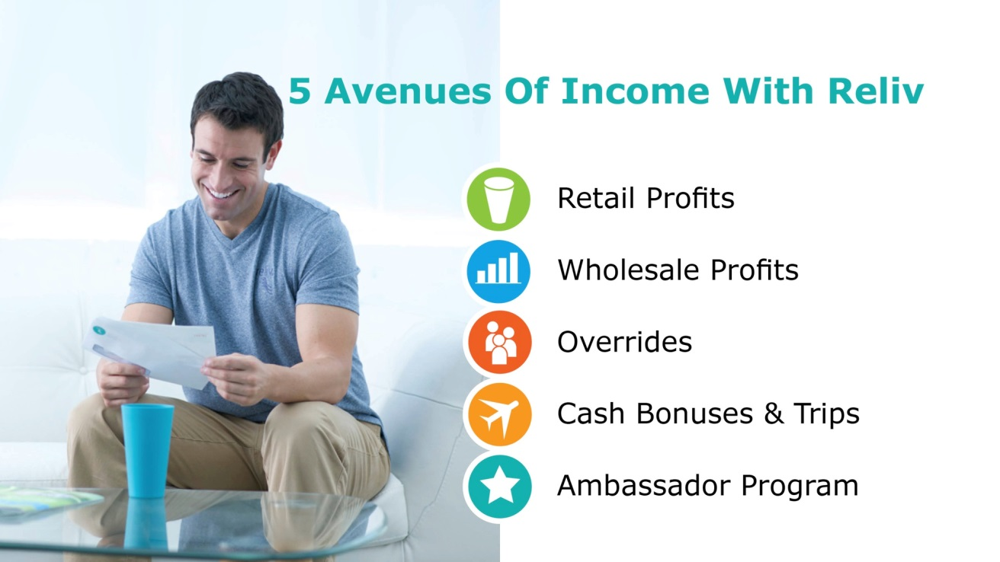
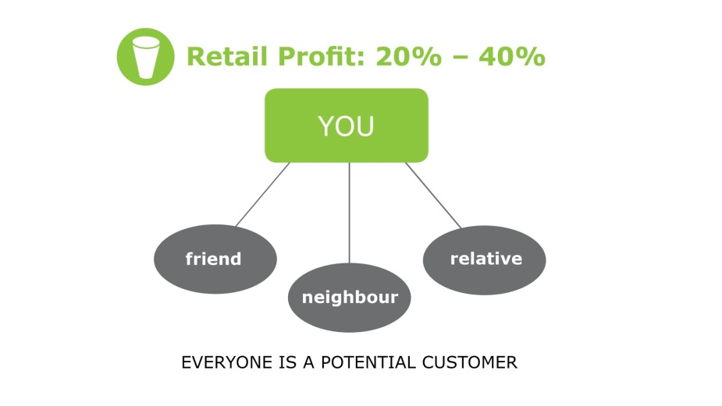
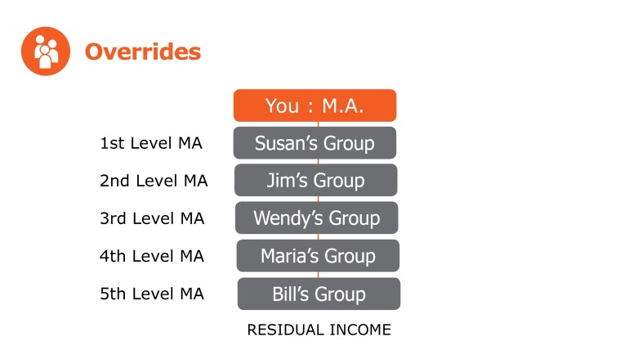
Compensation Plan
Learn how to explain the compensation plan to your Distributors
Learn how to write it out

Slide 35




Promotions and Incentives
Visit your regional Reliv website and be sure to sign up for e-blasts to find out about the latest promotions and incentive trips.

Slide 36



Big Goals = Big Rewards

Slide 37
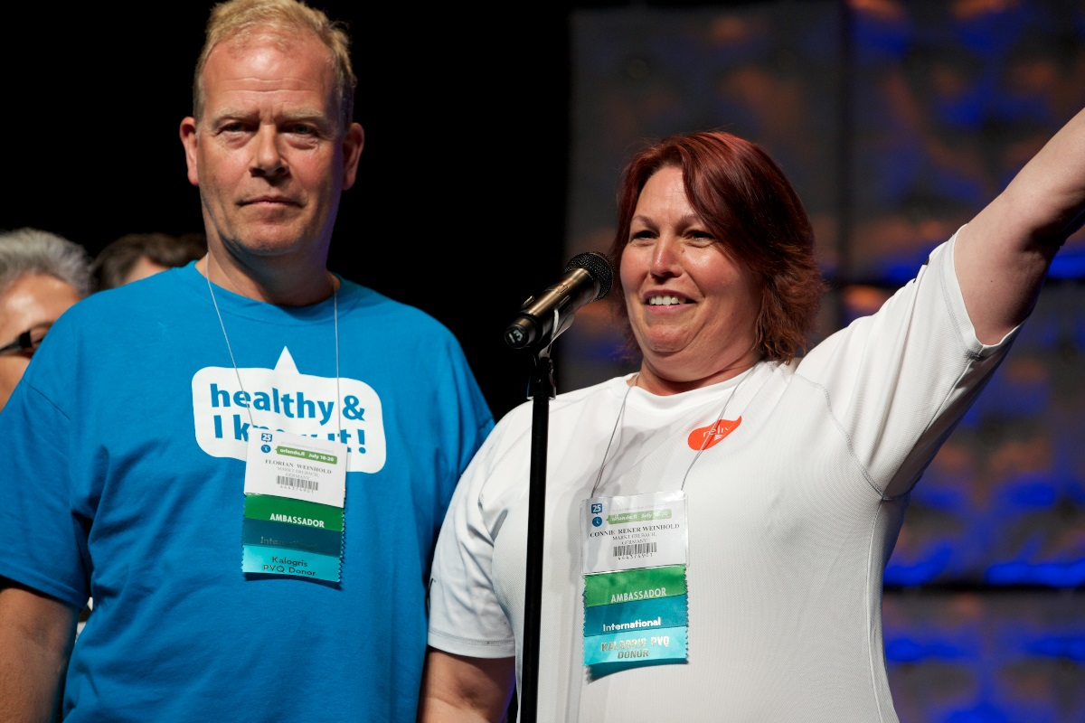
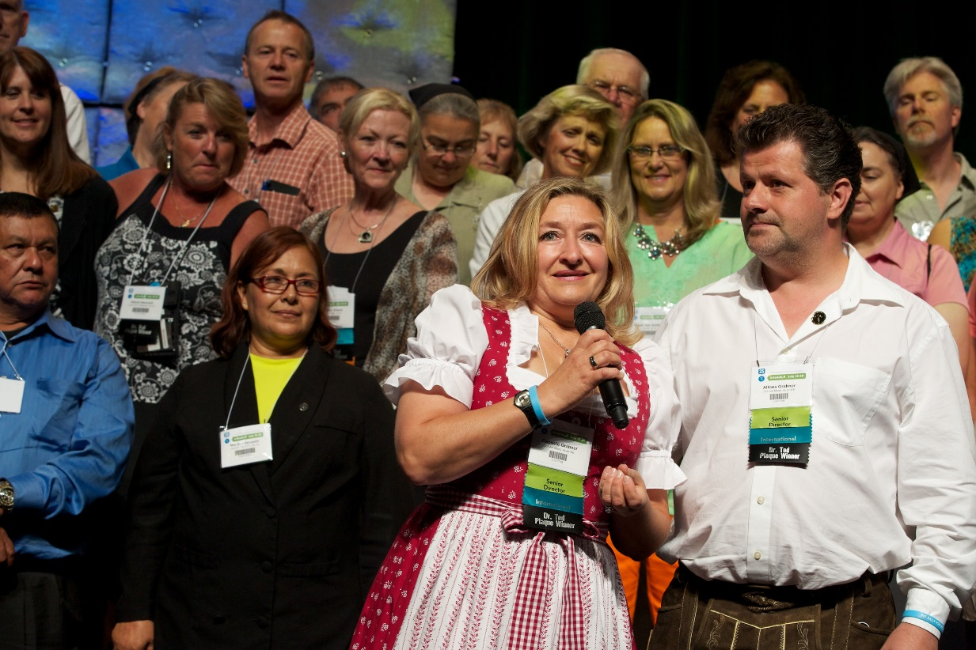
Who’s Next?
EVERYONE will be hearing about Reliv,
make sure they hear about Reliv from YOU!

Slide 38
The Only Variable
Same products
Same compensation plan
Same System
The only difference is YOU!
Whose life are YOU going to change today?

