Slide 1
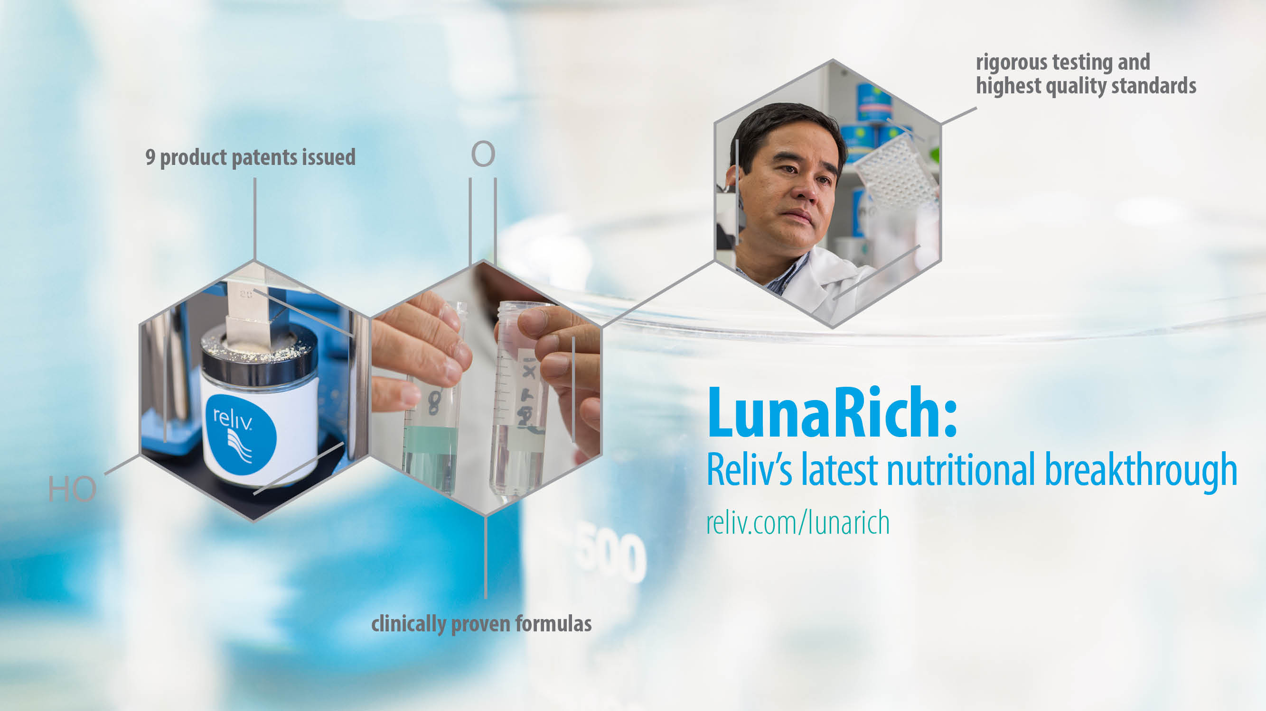

Slide 2


Slide 3


Slide 4


Slide 5


Slide 6


Slide 7


Slide 8


Slide 9


Slide 10
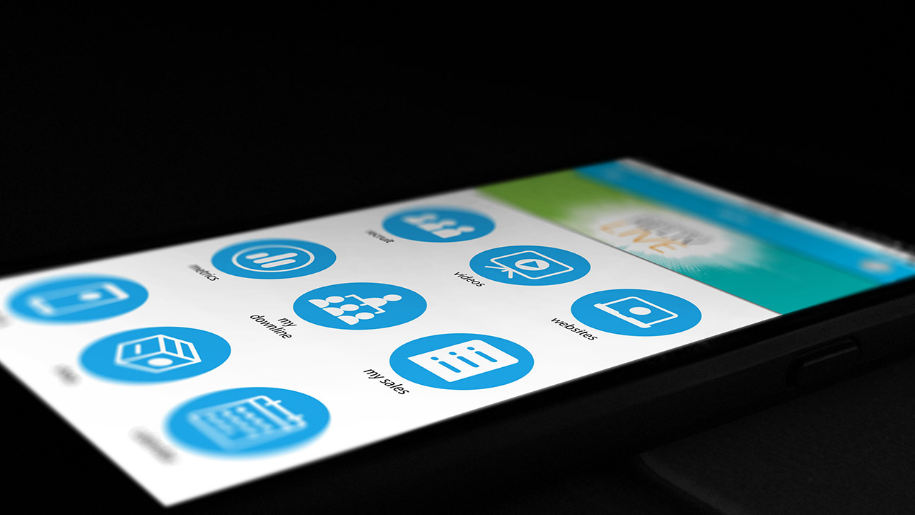
GET the reliv mobile app!
Track, manage and grow your business even on the go.

Slide 11


Slide 12
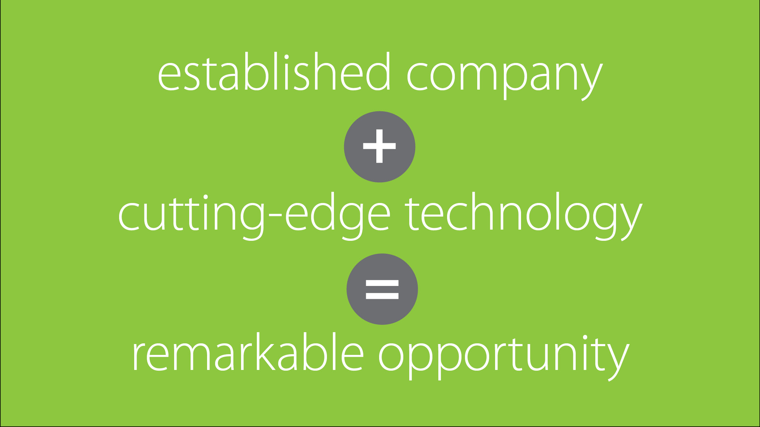

Slide 13


Slide 14


Slide 15


Slide 16


Slide 17

Listen at reliv.com/podcast or in iTunes

Slide 18
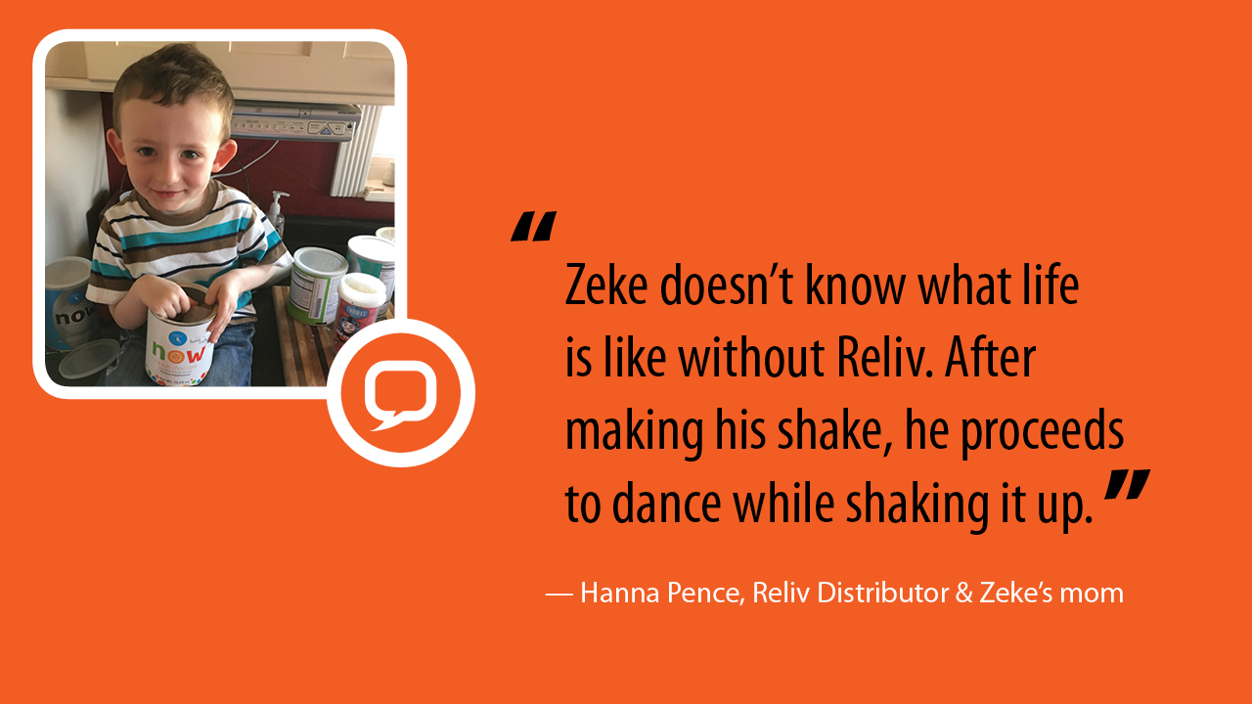

Slide 20


Slide 21


Slide 22


Slide 23


Slide 24


Slide 25


Slide 26


Slide 27


Slide 28


Slide 29


Slide 30


Slide 31


Slide 32


Slide 33


Slide 34
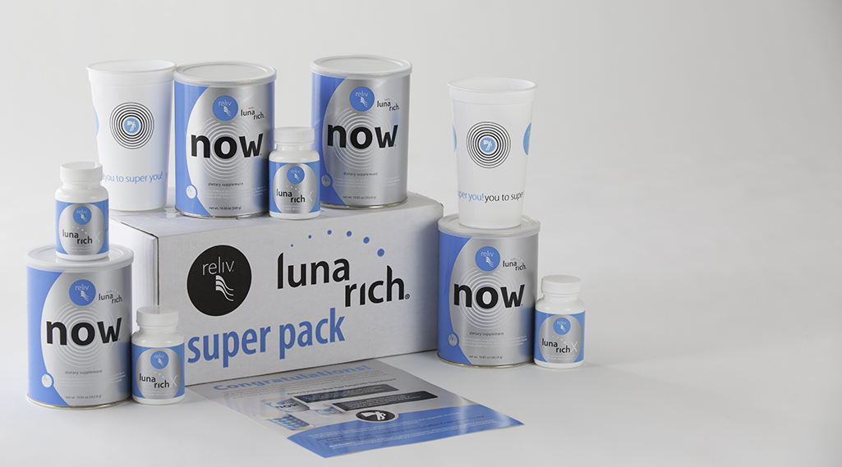
you to super you!
Power Up with the
LunaRich® Super Pack!

Slide 35


Slide 36


Slide 37


Slide 38


Slide 39


Slide 40


Slide 42


Slide 43


Slide 44


Slide 45
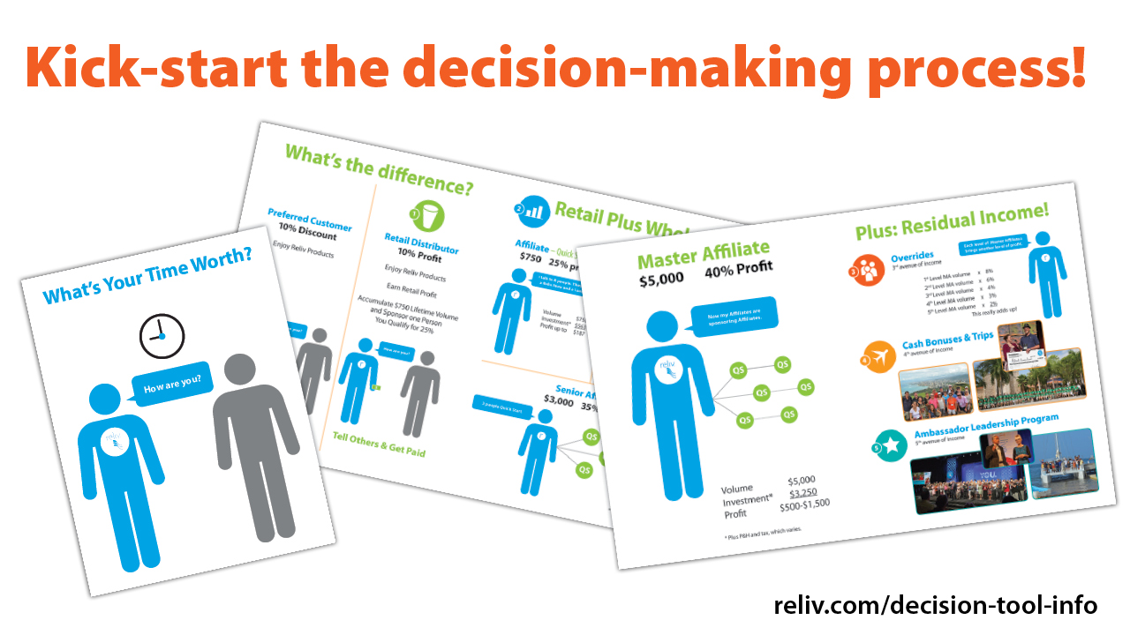
reliv.com/p/decision-tool

Slide 46


Slide 47


Slide 48


Slide 49


Slide 50


Slide 51


Slide 52


Slide 53


Slide 54


Slide 55


Slide 56


Slide 57


Slide 58


Slide 59


Slide 61


Slide 62


Slide 63


Slide 64


Slide 65


Slide 66


Slide 67


Slide 68


Slide 69


Slide 70


Slide 71


Slide 73


Slide 74


Slide 75


Slide 76


